Slide 1
CSC371-Database Systems I Lecture-12 (Lab) (Fall 2023)

Slide 2
Previous Lecture Review
SQL Joins
Outer Joins
Left Outer Join
Right Outer Join
Full Outer Join
Self Join

Slide 3
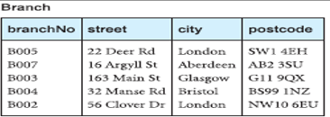
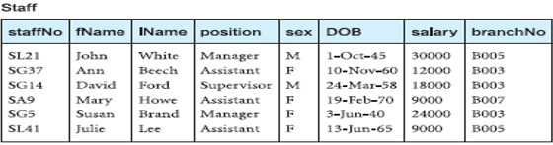
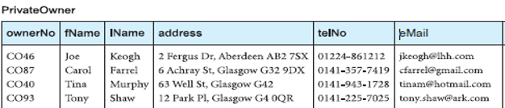
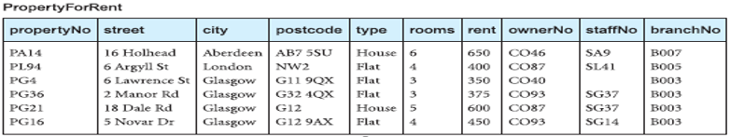

Slide 4
Agenda
SQL Sub Query

Slide 5
SQL Sub Query
A subquery is an SQL query nested inside a larger query.
A subquery may occur in :
A SELECT clause
A FROM clause
A WHERE clause
A subquery can be treated as an inner query, which is a
SQL query placed as a part of another query called as
outer query.
The inner query executes first before its parent query so that
the results of inner query can be passed to the outer query.
Must be enclosed in parentheses

Slide 6
Usually added within the WHERE Clause of another SQL SELECT statement
You can use the comparison operators, such as >, <, or =.
The comparison operator can also be a multiple-row operator, such as IN, ANY, or ALL.
You can use a subquery in a SELECT, INSERT, DELETE, or UPDATE statement to perform the following tasks:
Compare an expression to the result of the query.
Determine if an expression is included in the results of the query.
Check whether the query selects any rows.

Slide 7
Types of Subquery
Single row subquery : Returns zero or one row.
Multiple row subquery : Returns one or more rows.
Multiple column subqueries : Returns one or more columns.
Correlated subqueries : Reference one or more columns in the outer SQL statement. The subquery is known as a correlated subquery because the subquery is related to the outer SQL statement.
Nested subqueries : Subqueries are placed within another subquery.

Slide 8

Staff members detail working at street ‘163 Main St’
Select staff.* from staff,branch Where staff.branchno = branch.branchno
Execute From clause and fetch both tables data.
Execute where clause and Create a temporary table with matching records
Display data according to mentioned attributes in select clause.

Slide 9
Alternate way with subquery
Seelct staff.* from staff where branchno=(select branch from branch where street =‘163 Main st’)
While we just need one record from branch table and matching of that record from staff table
Only three records

Slide 10
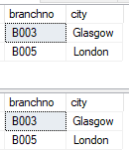
Can you find out branch number and its city of those staff members who are drawing more than 10000 salary.
select distinct branch.branchno, branch.city from branch
join staff on branch.branchno = staff.branchno and salary > 10000
select branch.branchno, branch.city from branch
where branch.branchno in (select branchno from staff where salary > 10000)

Slide 11
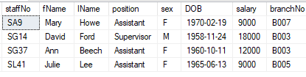
Subqueries with INSERT statement
MySQL
INSERT INTO staff2 SELECT * FROM staff WHERE position = ‘assistant’ OR position= ‘supervisor’
SQL Server
SELECT * INTO staff2 FROM staff WHERE position = 'assistant' or position = 'supervisor’
Select * from staff2

Slide 12

Subqueries with UPDATE statement
update staff2 set salary= salary+5000
where salary < (select avg(salary) from staff2)

Slide 13

Subqueries with DELETE statement
Delete from staff2 where branchno in (select branchno from branch where city = ‘London’)

Slide 14

Single Row Subqueries
Returns zero or one row to the outer SQL statement
Select staff.* from staff where branchno=(select branchno from branch where street ='163 Main st')

Slide 15

Multiple Row Subqueries
select branch.branchno, branch.city from branch
where branch.branchno in (select branchno from staff where salary > 10000)

Slide 16

SQL Nested subqueries
A subquery can be nested inside other subqueries
List the properties that are handled by staff who work in the branch at ‘163 Main St’.
SELECT propertyNo, street, city, postcode, type, rooms, rent
FROM PropertyForRent
WHERE staffNo IN (SELECT staffNo FROM Staff
WHERE branchNo = (SELECT branchNo FROM Branch
WHERE street = ‘163 Main St’));

Slide 17

Use of ANY/SOME and ALL
The keywords ANY and ALL may be used with subqueries that produce a single
column of numbers
Find all staff whose salary is larger than the salary of at least one member of staff at branch B003.
SELECT staffNo, fName, IName, position, salary
FROM Staff WHERE salary > SOME (SELECT salary FROM Staff WHERE branchNo = ‘B003’);

Slide 18

Use of ALL
Find all staff whose salary is larger than the salary of every member of staff at branch B003.
SELECT staffNo, fName, IName, position, salary FROM Staff
WHERE salary > ALL (SELECT salary FROM Staff
WHERE branchNo = ‘B003’);

Slide 19
Summary
SQL Sub Query

